Slide 1
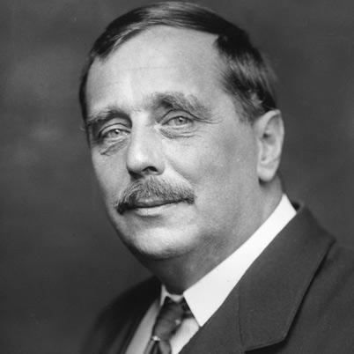
Herbert George Wells
By: D. S.

Slide 2
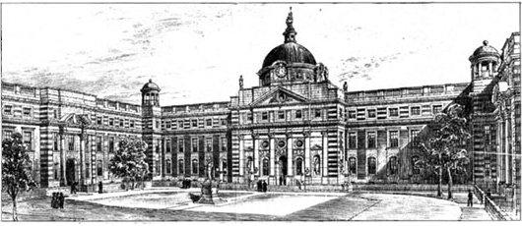
Timeline (Life)
1887- Left Royal College without getting degree, and became a science teacher.
1880- Becomes apprentice to draper, chemist, and and usher.
1866- September 21, Wells is born.
1874- Wells breaks his leg and starts to read many stories.
1884- Gets a scholarship to Normal School, which would later be Royal College, of science.

Slide 3
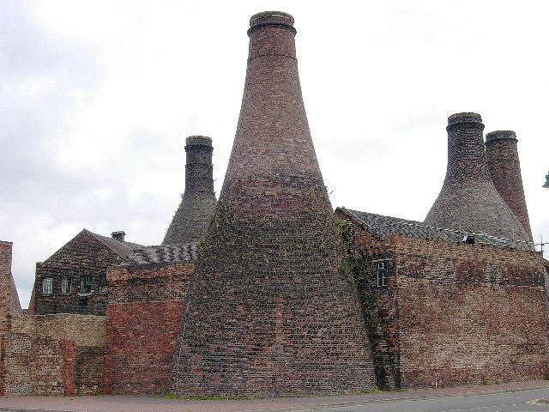
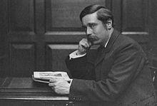
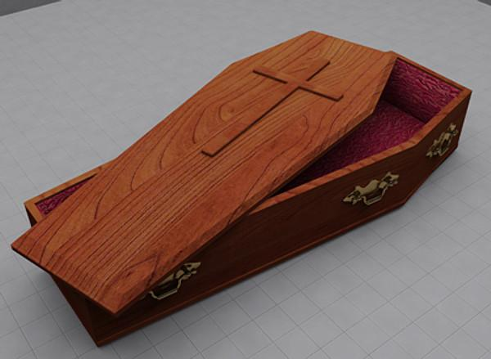
Timeline (Life)
1888- Lived in Stoke-on-Trent, which was very beautiful and artistic. This inspired him.
1895- Married one of his students, Amy Catherine Robbin. He has two kids with her= George Philip and Frank Richard.
1930- Stopped teaching and focused more on writing.
1890- After joining “The College of Teachers” he finally earned a degree in zoology.
1927- His wife dies of cancer.

Slide 4
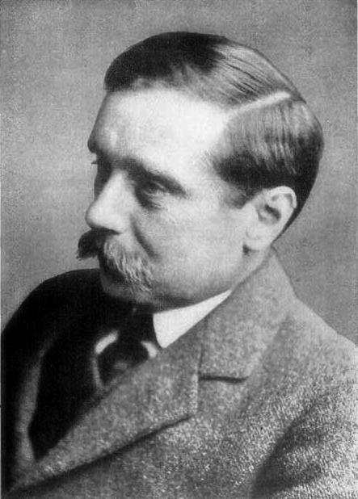
Timeline (Life)
1933- Wrote “The Shape of Things to Come” and predicted the second world war very closely.
1946- August 13 Wells dies at the age of 79.

Slide 5
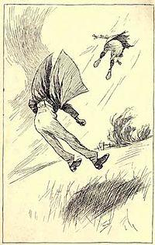
Timeline (Books)
1901- “The First Men in the Moon” was published and was scientific-romance
1895- “Time Machine” was published. It was sci-fi.
1897- “Invisible Man” was published. It also was sci-fi.
1896- “Island of Doctor Moreau” was published. This is also sci-fi.
1898- “War of the Worlds” was published and was sci-fi.

Slide 6
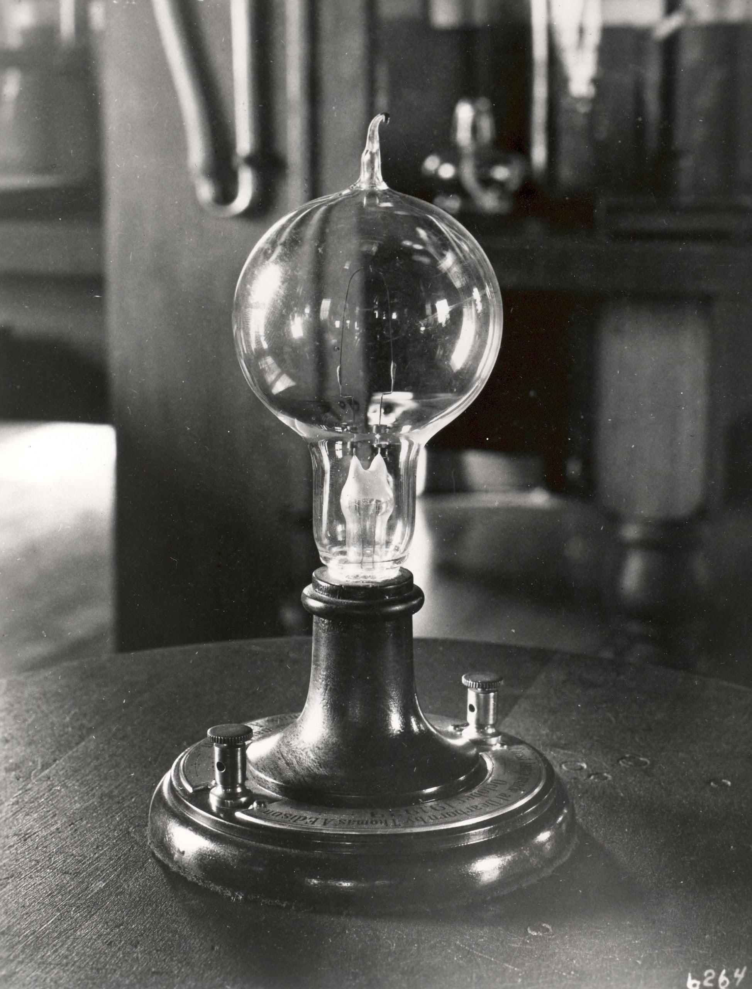
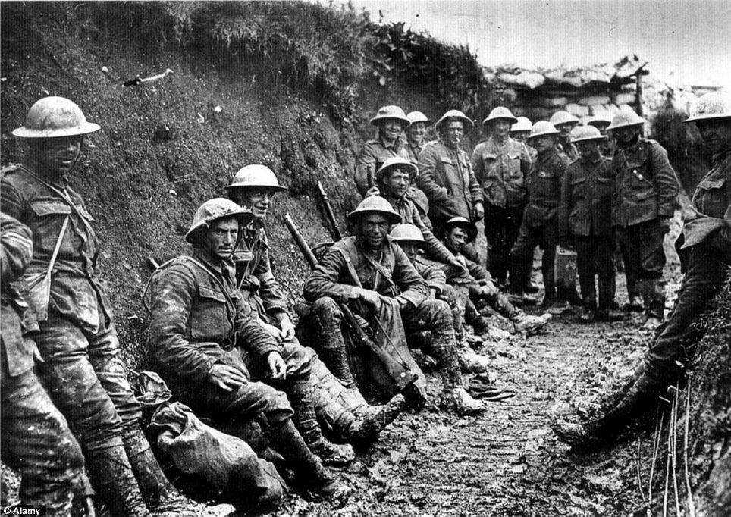
Timeline (History)
1934- On August 19 Adolf Hitler becomes president of Germany.
1883- The light bulb is invented by Thomas Edison.
1913- First assembly line is manufactured by Henry Ford
1900- On June 19 Hawaii becomes official US territory.
1914- World War 1 started on July 28.

Slide 7
THE END...
By: Donald
Herbert George Wells
Last Words- “Go away. I’m alright.”

