Slide 1
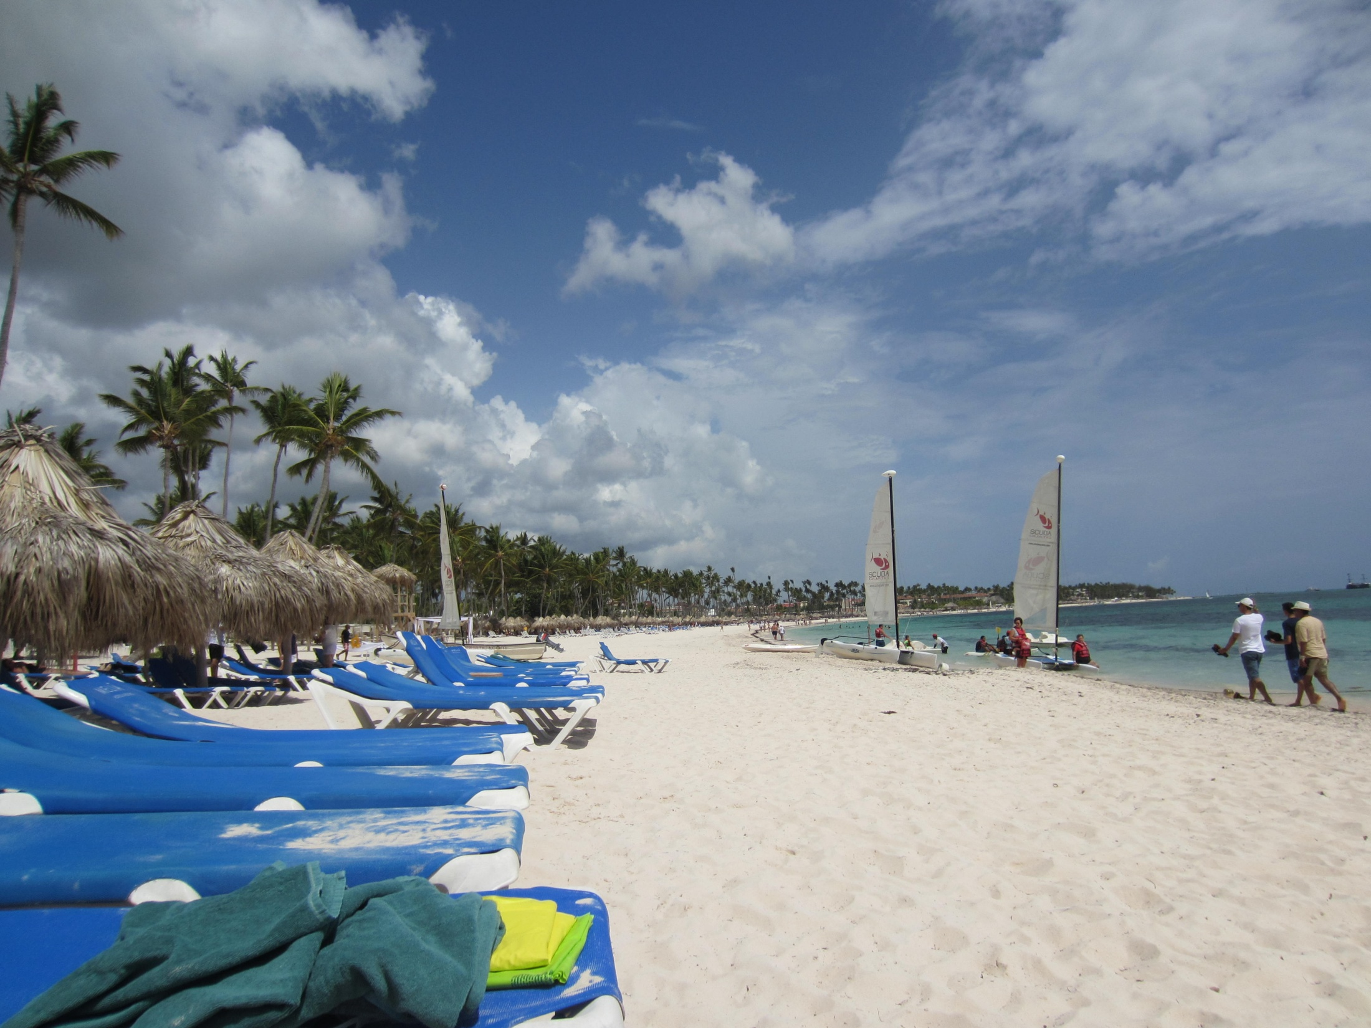
Sixteenth Summer
Written By: Michelle Dalton
Presentation By:
Eleana Pardo

Slide 2
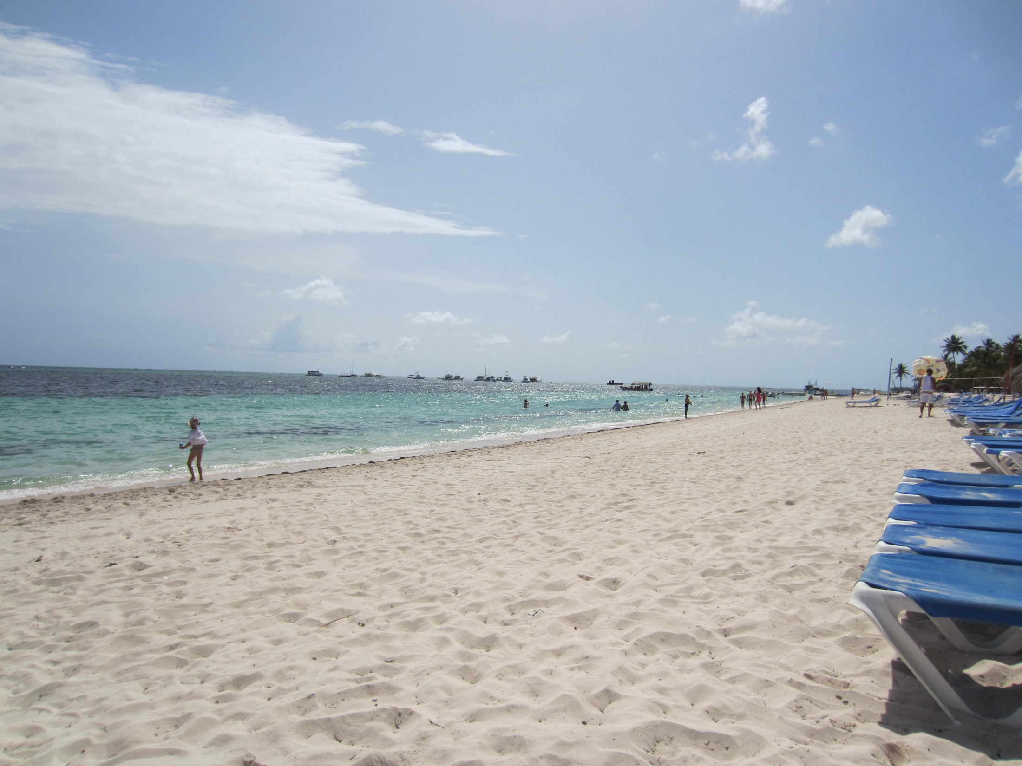
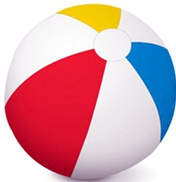
Table of Contents
Theme and Setting
Characters
Genre
3 Literary Devices
Biography of Author
Synopsis

Slide 3
Thank you for watching my presentation! Now, to show my thanks, I have prepared a surprise via the link below. Check it out!
http://www.powtoon.com/show/cvNkA5isIfY/sixteenth-summer/#/

Slide 4
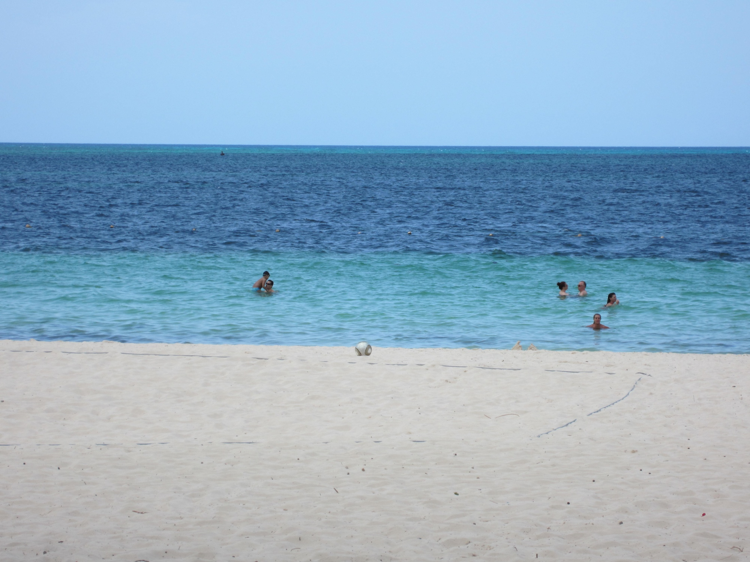
Main Characters
Anna
Will
Anna Patrick is the protagonist of this story because she is the main character. Furthermore, the story is written in first person via Anna’s point of view. Anna is a caring, family-oriented, loving, and kind girl who works at Scoops, her family’s ice cream shop on Dune Island, Georgia. Although Anna is a wonderful girl, she faces a not so wonderful problem when she meets Will…
Even though Will is Anna’s amazing boyfriend in this novel, he is the antagonist. This is because he presents the conflict in the story. Will is a caring, tall, fun, and loving boy who came to Dune Island expecting a boring summer. But, he doesn’t know that he is going to meet a girl this summer and have the best summer of his life. The two are in love, but can that love withstand 1,000 miles?
Table of Contents

Slide 5
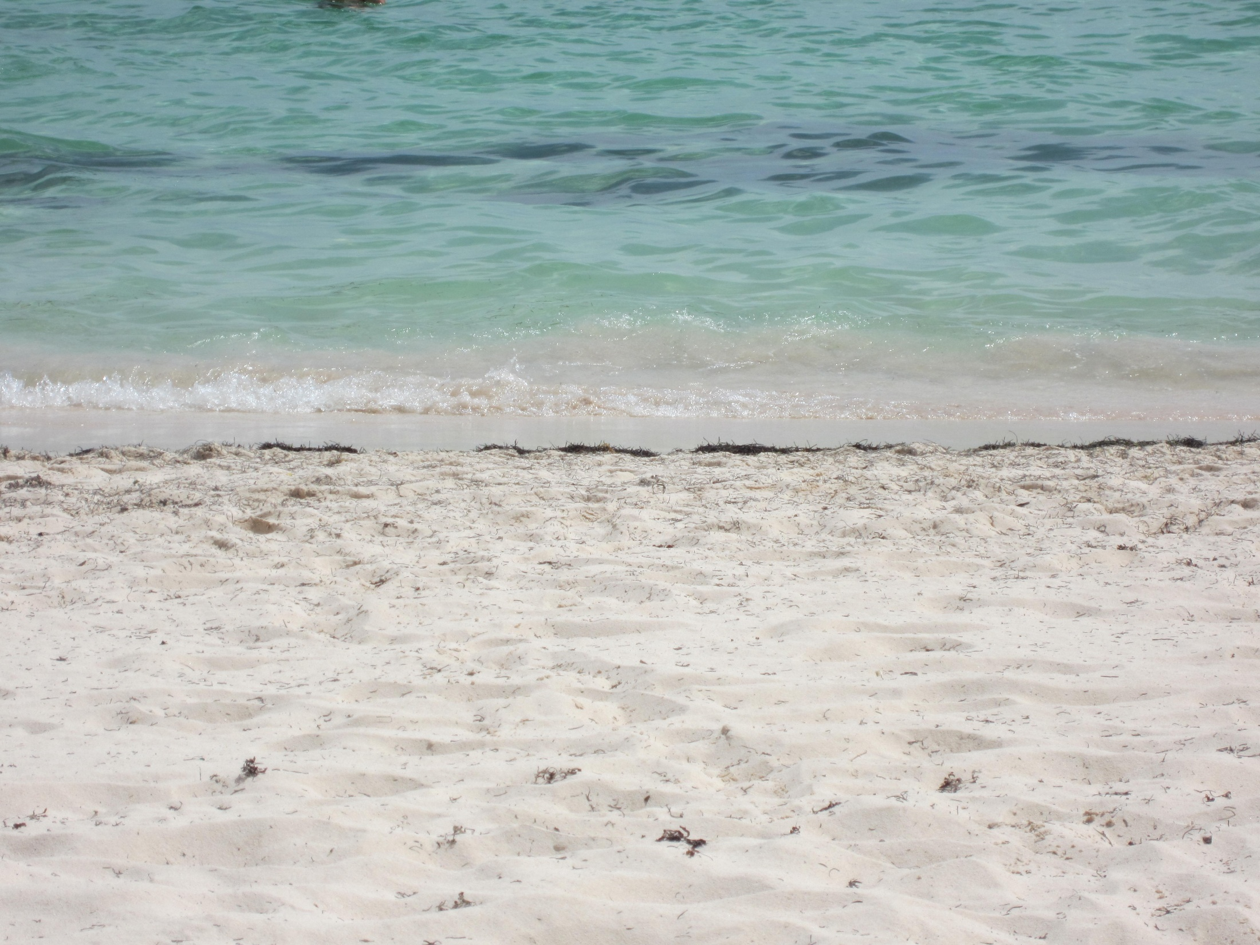
Theme And Setting
Theme
Setting
The theme in Sixteenth Summer is, “Live each moment as if it were your last.” This theme is demonstrated greatly throughout the story. Anna and Will both know that Will will have to go back to New York at the end of the summer. But, their epic summer romance wants to keep going and they don’t want this summer to end. The summer has to eventually end though, so Will and Anna make it their mission to spend as much time together as possible and live each moment as if it were their last!
The setting in this story is on Dune Island, Georgia during the summer. Some main locations within Dune Island that the characters visit are Scoops, Anna’s family ice cream shop, The Swamp, the gross restaurant in the swampy area of the island, the beach, and Anna’s house. Also, the characters visit the Putt Putt Dune Island, and Will’s home for the summer. Will and Anna go to the lighthouse on their last night together. These are some of the characters’ favorite spots on Dune Island in this awesome summer novel!
Table of Contents

Slide 6
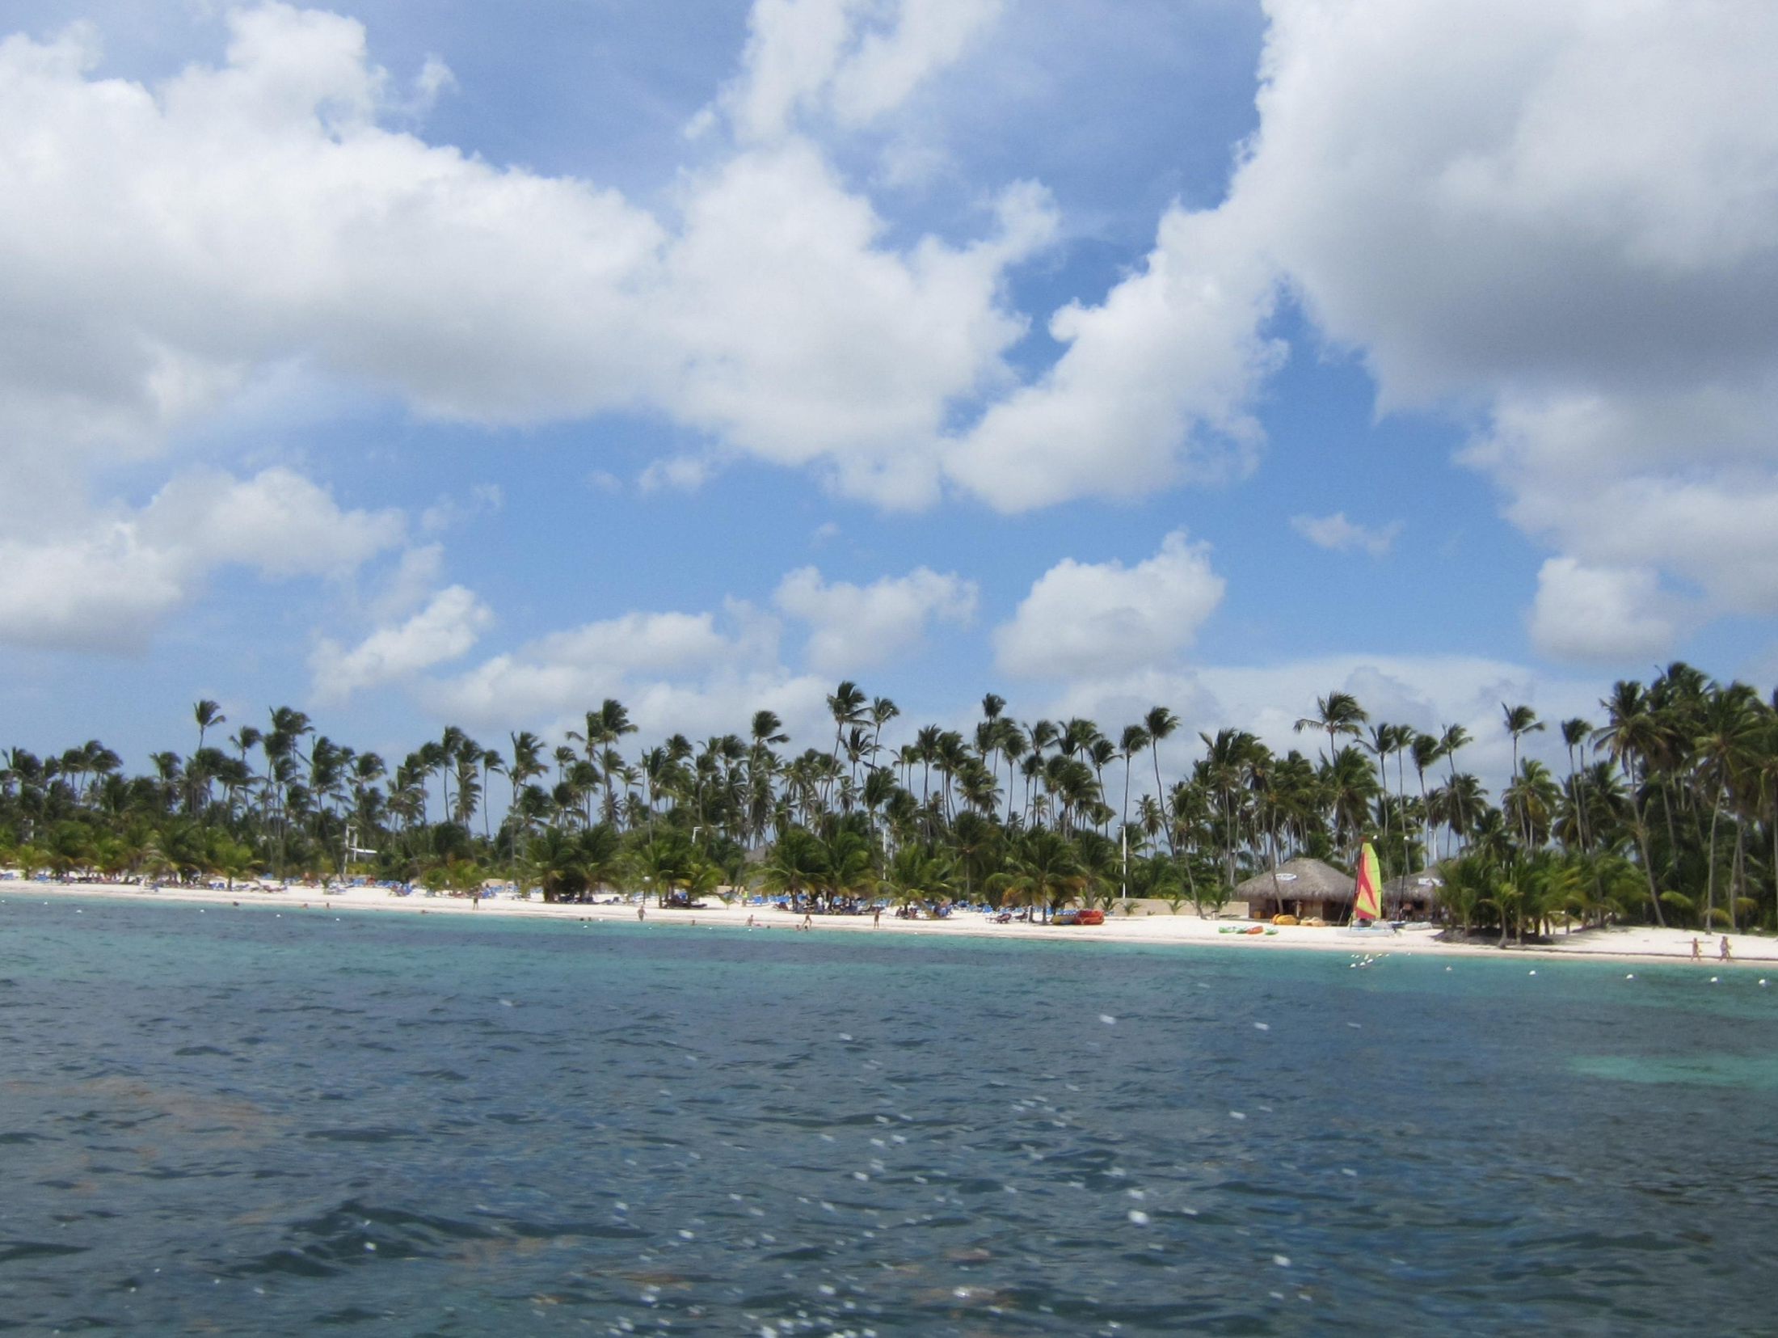
Genre
The genre of this story is realistic fiction because the story could be someone’s reality. The story makes you feel as if you are getting to know real people that are going through a believable situation. Further, the characters live in places that could be real, are involved in events that could possibly take place, and the story takes place in the present. These qualifications clearly show that this story is realistic fiction!
Table of Contents

Slide 7
Michelle Dalton
Michelle Dalton is a pseudonym. The author of this novel’s REAL name is Elizabeth Lenhard. She has written 47 novels including A Chick With Sticks. Some fun facts about Lenhard are (written in first person on the website):
My favorite comfort foods are: Cinnamon toast, PB & J, grilled cheese sandwiches, and, of course, ice cream. Particularly ice cream in a cone.
I was born exactly a year after Apollo 11 took off for the moon. Every year on my birthday, my older brother reminds me of this.
I didn’t walk until I was two years old. Nothing was wrong with me. I was just lazy.
Fun facts and biography from:
"Elizabeth Lenhard." Elizabeth Lenhard. N.p., n.d. Web. 10 Sept. 2014.
"An Introduction." Elizabeth Lenhard. N.p., n.d. Web. 10 Sept. 2014
Table of Contents

Slide 8
Synopsis
Anna Patrick was ready for a normal Dune Island summer, but she gets the complete opposite! When she notices Will at the Bonfire to kick off summer, she falls in love. Ironically, he felt the same way and the happy couple had an epic summer romance filled with bike rides, days at the beach, at Scoops, at the Swamp, at Putt Putt Dune Island, and many other places. Nothing could break them apart, except time. Will only came here for one summer and when August comes, he would be on his way back to New York. Will they have a long distance relationship or will this epic summer romance end drastically? Read the book to find out!
Table of Contents

Slide 9
3 Literary Devices
“The water was calm and sleepy this morning as if it, too, was drained after the holiday.” (162)
This literary device is personification because the ocean can’t be sleepy or drained. Those two characteristics that are being used to describe the ocean are human feelings therefore making this connection personification!
2) “So I swallowed my self consciousness and smiled at Will’s mom.” (137)
This literary device is a metaphor because you cannot physically swallow your self consciousness. This action does not happen but is used to show that she was nervous and then got over her nervousness and smiled!
3) “My voice was as flat as my feelings.”(88)
This literary device is a simile because it compares two unlike things using the word “as”. In this case, the words “voice” and “feelings” are being compared because her feelings aren’t happy and neither was her voice. Her voice and feelings were “flat” or unhappy at the moment!
Table of Contents

